Slide 1
Automatic Attendance System
Capstone Project Warmup
Team Brainanza
October 3, 2022

Slide 2
Agenda
01. Introduction
02. Proposed Application
Brief introduction on the problem statement
Application deliverables at the end of implementation
03. User Diagram
04. Technology Stack
User flow diagram explaining the design layout of end-product
Proposed tools and techniques for implementation of the solution

Slide 3

Introduction
Attendance plays an important role in any organization being it an educational institute or companies. So, it is very important to keep record of the attendance.
The problem arises when one has to take attendance manually. This method face difficulties such as: taking attendance by signing the list leads to cheating, omissions for latecomers, time consuming to callout names and to confirm the list.

Slide 4
Introduction
Thus, conventional attendance system leads to human error and a lot of maintenance is required. Time consumption is an important point of concern in this system.
There are other digital solutions already available for this problem like voice recognition, iris recognition and fingerprint recognition which require interaction to work.
So, seeing all these problems we have thought to revolutionize it using modern era digital tool i.e., FACE RECOGNITION. Our project will ensure more precision and negligible manual work. The project is structured in order to overcome the problems of conventional systems. Face recognition and then marking and showing the attendance is our project all about. The database for all student images will be stored in a folder and upon matching the face of the student from the images the attendance will be marked else face will be ignored.

Slide 5
Proposed Application
The application will be hosted on Cloud Platform – Microsoft Azure. The created code and all the required repositories would be deployed on cloud.
A low code web interface would be created to capture live video stream and also to show the attendance sheet. Connectors will help transfer input and output feed between the web page and the code.
For the training data, several images of the class members would be placed in folder on the cloud repository.

Slide 6
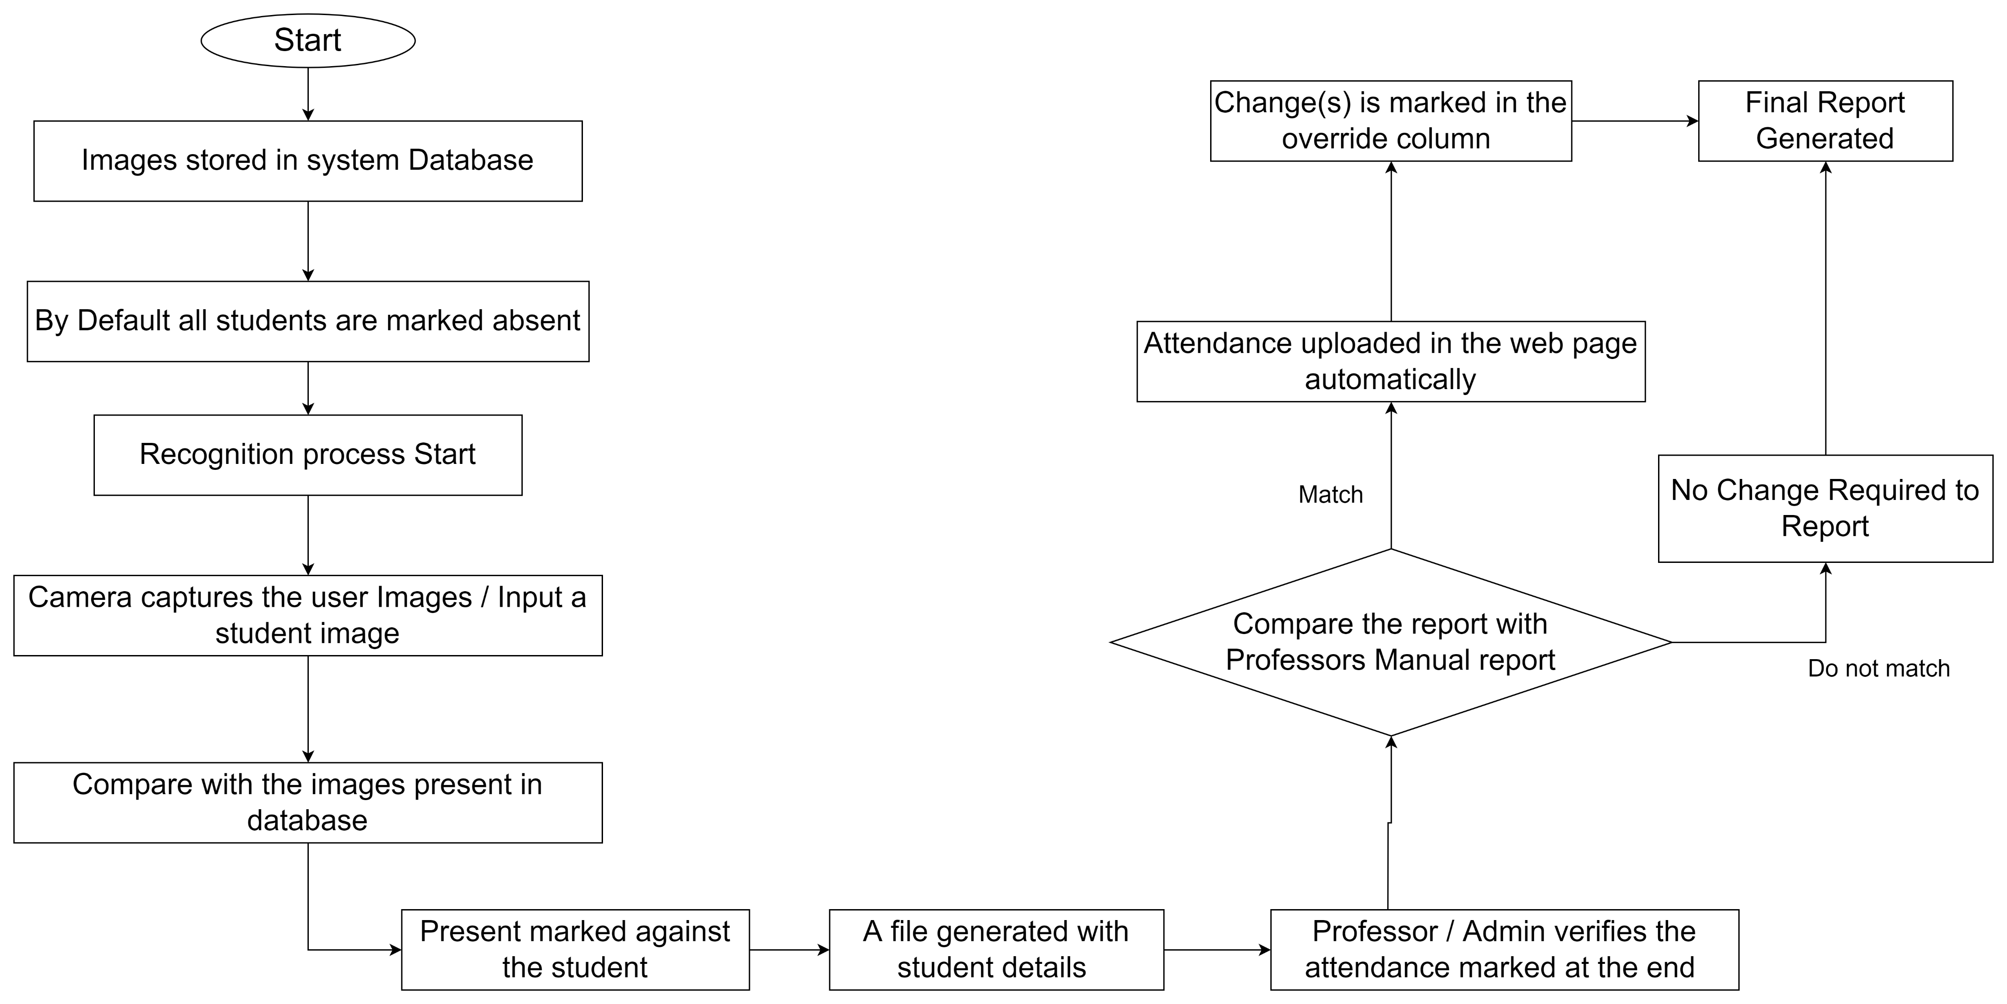
User Diagram

Slide 7
Technology Stack
Software Required:
Programming Language: Python
Pycharm
Jupyter Notebook
Git
Modules to be used:
Python Imaging Library (PIL) to add image processing capabilities
OpenCV library which has more than 2500 optimized algorithms to detect and recognize faces, identify objects, find similar images from an image database, remove red eyes from images taken using flash, follow eye movements etc.
Tkinter is an open source, portable graphical user interface (GUI) library designed for use in Python scripts
Shutil to provide high-level file operations and automate the process of file handling
Numpy, Pandas
Algorithms to be used:
Face Detection: HAAR CASCADE
Face Recognition: LBPH

Slide 8
HAAR CASCADE
Will be used to tell whether an image of arbitrary size contains a human face and if so, where it is. Face detection can be performed based on several cues: skin color (for faces in color images and videos, motion (for faces in videos), facial/head shape, facial appearance, or a combination of these parameters
It is an algorithm that can detect objects in images, irrespective of their scale in image and location.
Uses the cascading window, and it tries to compute features in every window and classify whether it could be an object.
The OpenCV library manages a repository containing all popular HAAR Cascades that can be used for Human face detection

Slide 9
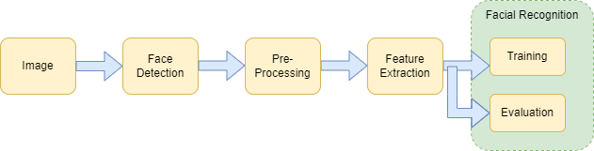
LOCAL BINARY PATTERNS HISTOGRAMS (LBPH)
Algorithm used to recognize the face of a person by comparing the input facial image with all facial images from a dataset with the aim to find the user that matches that face.
Steps in algorithm implementation:
Prepare Training Data: Read training images for each person along with their labels, detect faces from each image, and assign each detected face an integer label of the person it belongs.
Train Face Recognizer: Train OpenCV’s LBPH recognizer by feeding it the data we prepared in step 1.
Prediction: Introduce some test images to the face recognizer and see if it predicts them correctly.

Slide 10
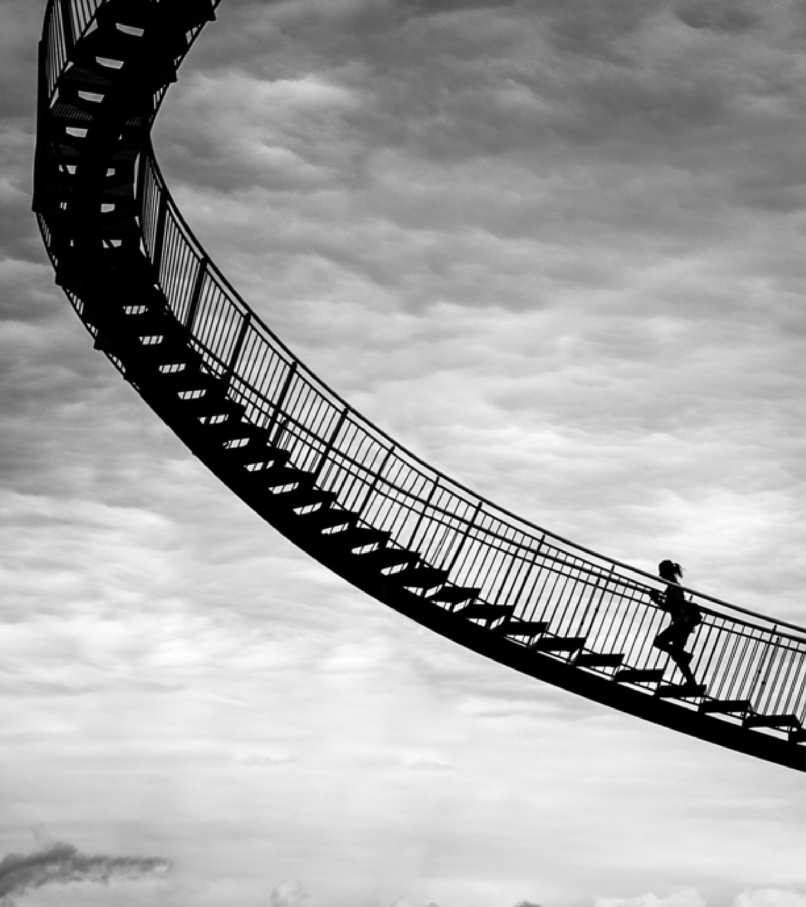
Thank you
Team Brainanza
Team Lead – Jasmeet Kaur

